Slide 1
Music Trends Through the Generations
Dayna Cole
Joshua Covarrubias
Rachel Taylor
Iryna Vitkovych
Danielle Woodworth

Slide 2
Background
Music has been around in various forms for many many years, with some forms even dating back to over 35,000 years ago. Throughout time, music has been used within religions, to celebrate, to share messages, to inspire, to express oneself, and to generally entertain. Across the decades, how music is created, shared, consumed, and utilized has evolved rapidly and innovatively.
Since the start of the new millenia, music consumption has been digitized and consumers are now more likely to consume music via streaming than in previous generations’ where consumption was via physical or analog mediums.
Depending on what (recent) generation you may have been born in, the consumption, listening habits, and popularity of genres or music types may differ. Our team was interested in analyzing music trends of the past to determine if its possible to predict the trends of the next generation to come.
🎶
Notes:
Speaker: Danielle

Slide 3
Objectives
Generations* ( Based on one’s birth year)
🎹Baby Boomers (1946-1964)
🎸Generation X (1965-1979)
🥁Millennials (1980-1994)
🎧Generation Z (1995-2009)
🎤Generation Alpha (2010 -2024)
In order to analyze streaming data to better understand music trends across listening generations*, we will utilize data from one of the top music streaming companies in the world, Spotify. This data was retrieved via Spotify’s API as well as a Kaggle dataset of Spotify songs with different genres and their audio features**.
Once our data has been cleaned and merged, we were able to do initial data exploration based on our objectives. Our objectives aimed to lead us to the overarching question of “Based on listening trends of the past, is it possible to determine what will be popular in the next generation ( Generation Beta)”
Code Crusaders’ Objectives
How has the number of tracks (songs) changed over time, specifically across each generation.
Understand how have features of tracks evolved over time? What features seem to be the most common in each listening generation.
Determine how genres have evolved and if there are consistent genres that stand the test of time.
Notes:
Speaker: Danielle

Slide 4
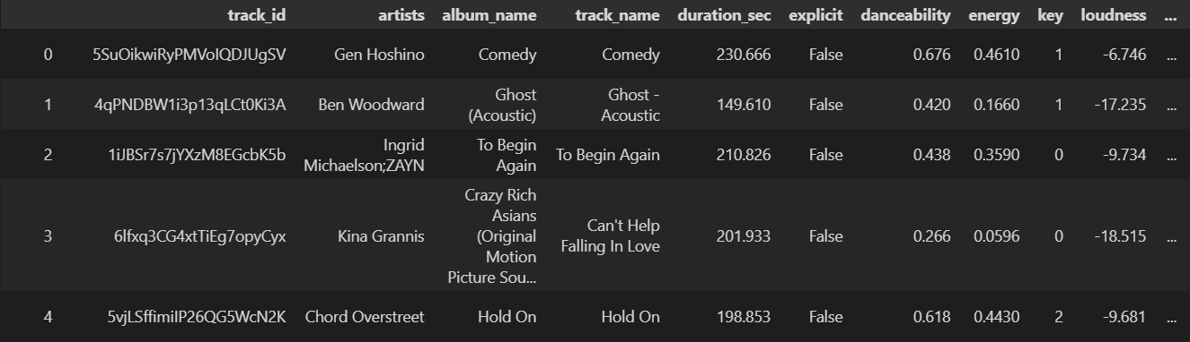
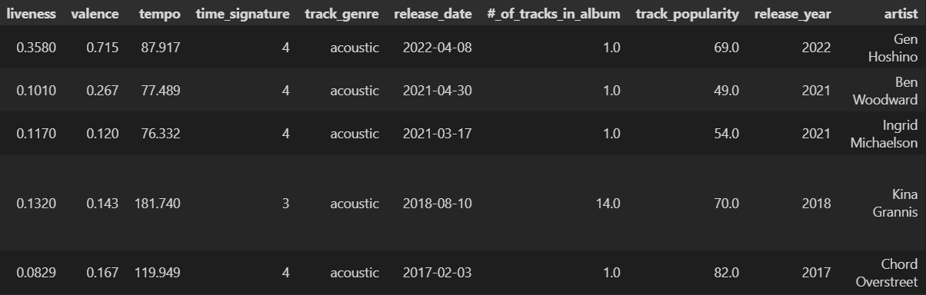
Overview of Our Dataset
Notes:
Speaker: Josh

Slide 5
Overview of Our Dataset Cont’d
Tracks were released anywhere between 1899-2023
Dataset was created in October of 2023 so we needed to grab current popularity scores
114,000 rows of data
Created new columns
Release_date, release_year, #_of_tracks_in_album, and track_popularity
Spotify’s API has limitations on the amount of data that you use.
1 hour time limits on the API key
30 second window call limit intervals
With the time limits to Spotify’s API, we could only get data for 77,701 rows
Removed duplicate albums and song names
Includes any cover songs or live/extended/remastered versions.
Removed album or song names with any foreign letters and languages
With both methods of removing rows, this only got us down to around 81,827 rows
Lastly, removed 4,126 random rows
Notes:
Speaker: Josh

Slide 6
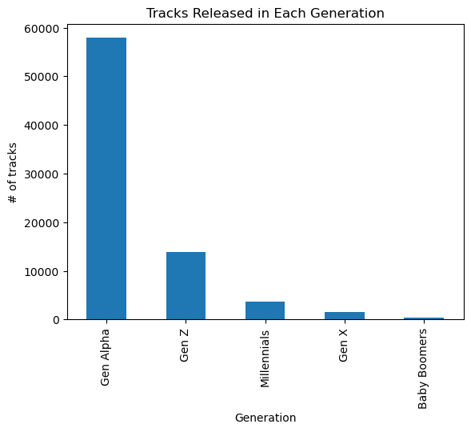
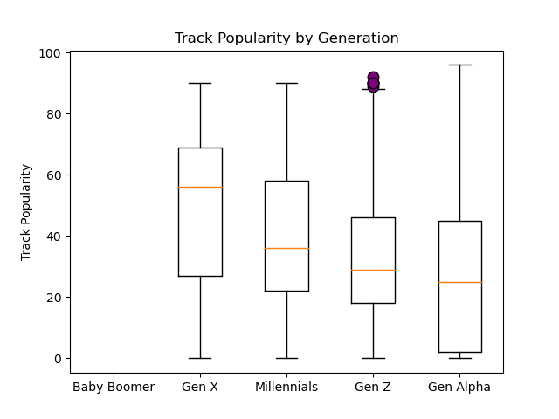
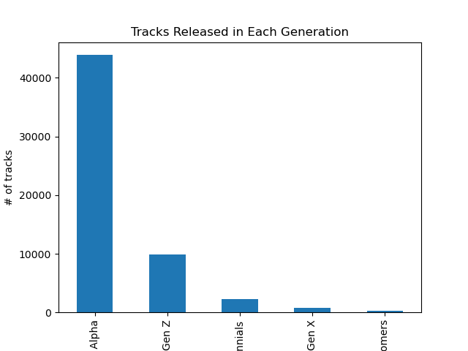
Initial Data Analysis Findings
Across generations we started looking at the volume of tracks released in each listening generation.
Notes:
Speaker: Rachel
Things to note:
Tracks Released in each generation:
This data is based on streaming information, therefore some track release dates for songs released prior to streaming may be the date the song was digitally released and not the original release date. We take this into account by not assuming that the lower number of songs released during Millennial, Gen X, and Baby Boomers are likely higher than what they show and Gen Z and Gen Alpha are more accurate.
We can also assume that the number of tracks released in later generations (Millennial, Gen Z, and Gen Alpha) is higher due to there being an increase opportunity to independently release and self release music (eg. In previous generations, artists had to be signed to a label to record, release, and distribute their music, thus having a higher barrier to entry and in later generations there are more independent ways to release music ( an individual can upload their music to Spotify themselves with a lower barrier to entry than being signed to music label)
Track Popularity by Generation:
Track popularity is defined as The popularity of a track is a value between 0 and 100, with 100 being the most popular. The popularity is calculated by algorithm and is based, in the most part, on the total number of plays the track has had and how recent those plays are. Generally speaking, songs that are being played a lot now will have a higher popularity than songs that were played a lot in the past. Duplicate tracks (e.g. the same track from a single and an album) are rated independently. Artist and album popularity is derived mathematically from track popularity.
With this in mind, we see that songs released during Gen Z ( in the last few years) have outliers in popularity, likely due to songs that are new and popular and are viral across social media platforms as oppose to songs released in past generations that may have been popular upon release, but are not streamed at a high rate currently.
We also see that the mean of popular

Slide 7
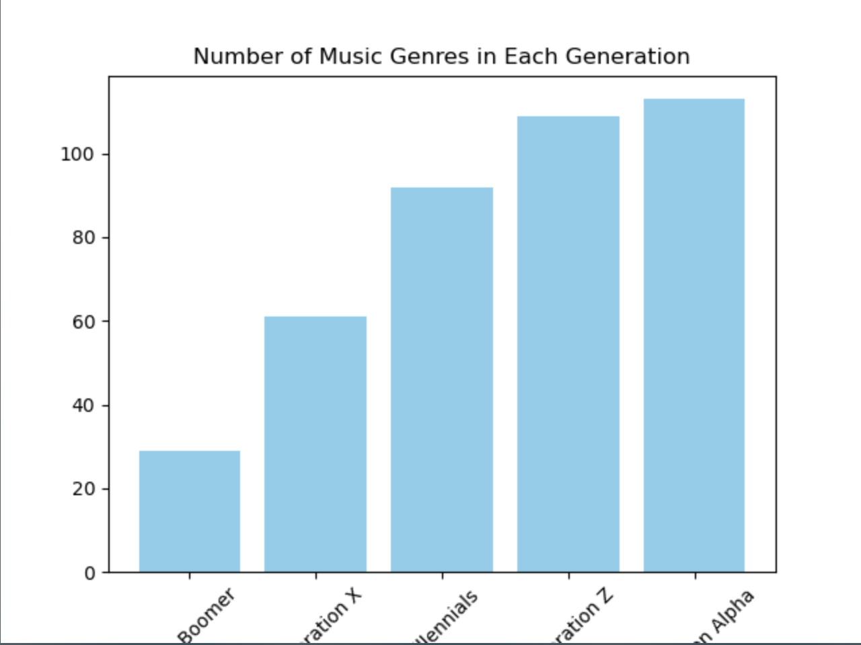
Initial Data Analysis Findings Cont’d
We then look across generations to see the top genres for tracks released during each listening decade.
As we are currently in Generation Alpha, this year being Q1 2024, we can see that already the # of genres have increased since last period of Generation Z.
How Spotify determines genres
Notes:
Speaker: Iryna
Genres count have increased over time
Genre count
Baby Boomers ~29
Gen X ~ 60
Millennial ~ 90
Gen Z - 105
Gen Alpha - 110
We can see that in each listening generation, the top 5 genres changes over time indicating that music tastes evolve over time or merge to produce similar genres that are influenced by one another. Spotify defines their genres

Slide 8
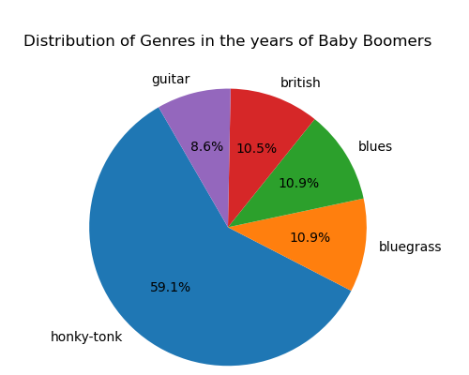
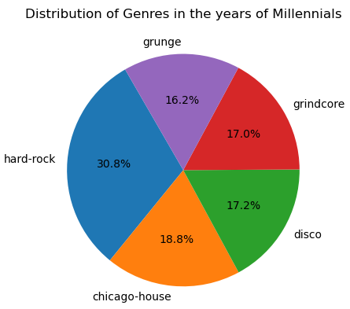
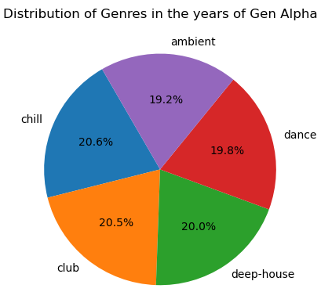
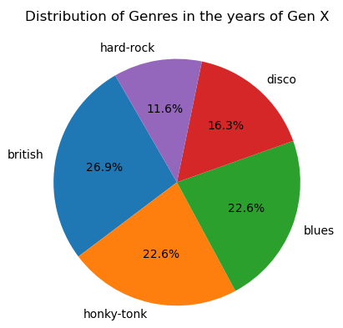
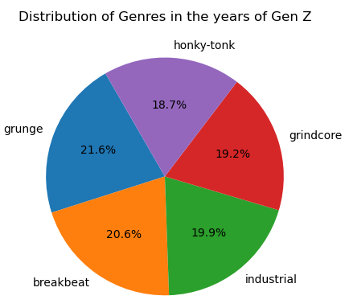
Initial Data Analysis Findings Cont’d
We then look across generations to see the top genres for tracks released during each listening decade
How Spotify determines genres
Notes:
Speaker: Iryna
Genres count have increased over time
Genre count
Baby Boomers -
Gen X -
Millennial -
Gen Z -
Gen Alpha -
We can see that in each listening generation, the top 5 genres changes over time indicating that music tastes evolve over time or merge to produce similar genres that are influenced by one another. Spotify defines their genres

Slide 9
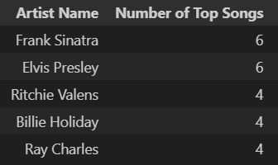
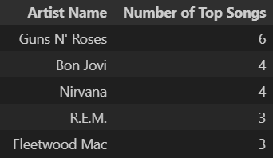
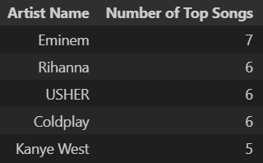
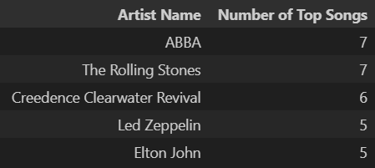
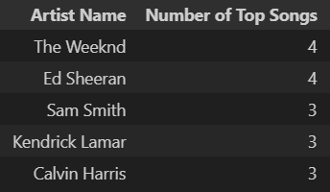
Artists with the Most Top Tracks in a Generation
Baby Boomers (64 artists):
Millennials (101 artists):
Gen Z (125 artists):
Gen X (108 artists):
Gen Alpha (53 artists):

Slide 10
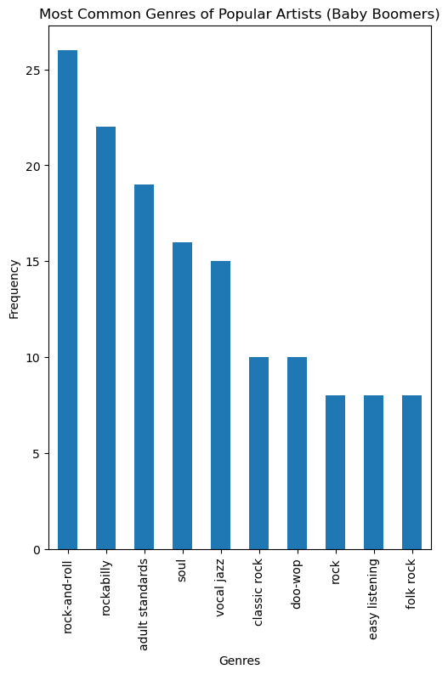
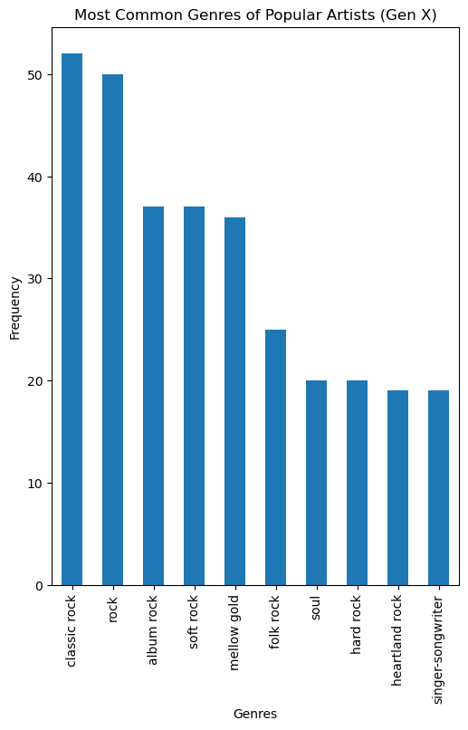
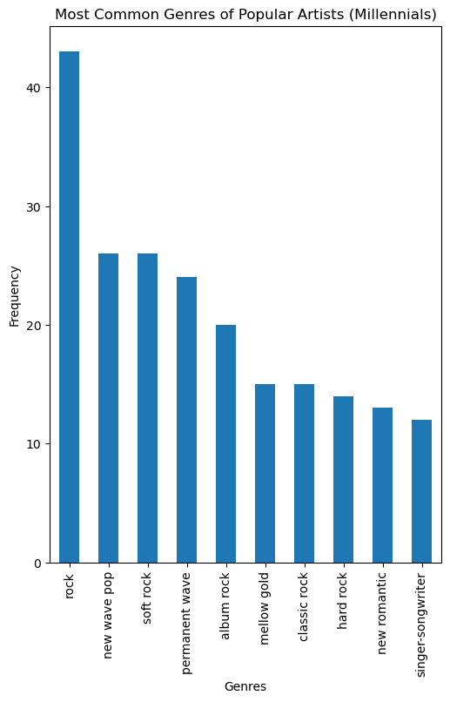
Top Artist Genres

Slide 11
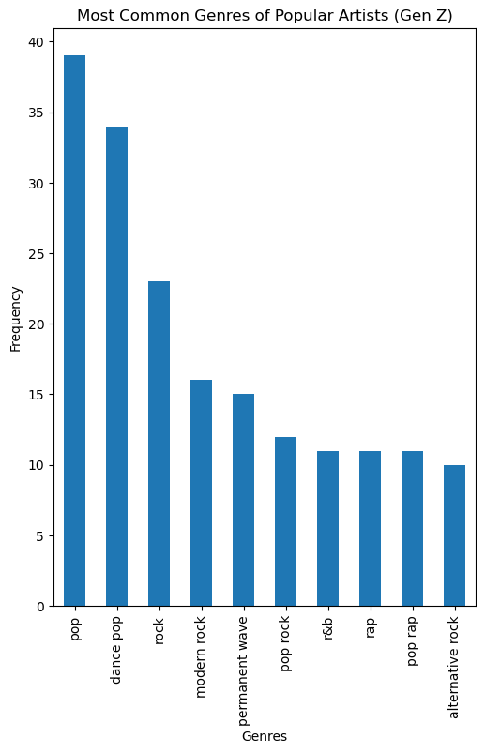
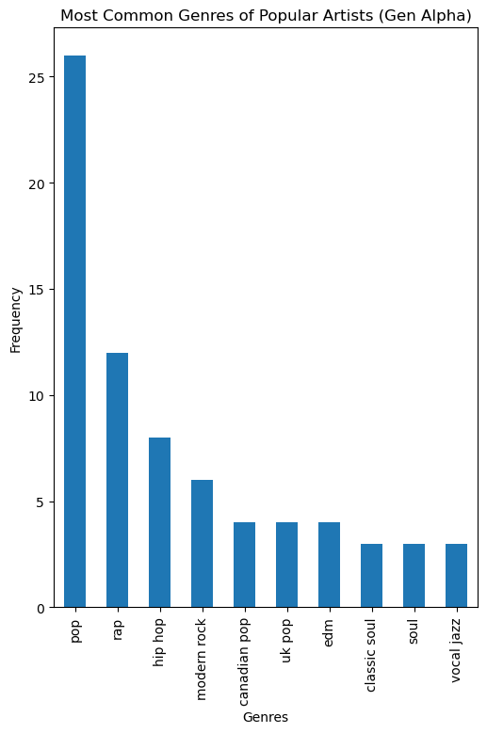
Top Artist Genres (cont.)

Slide 12
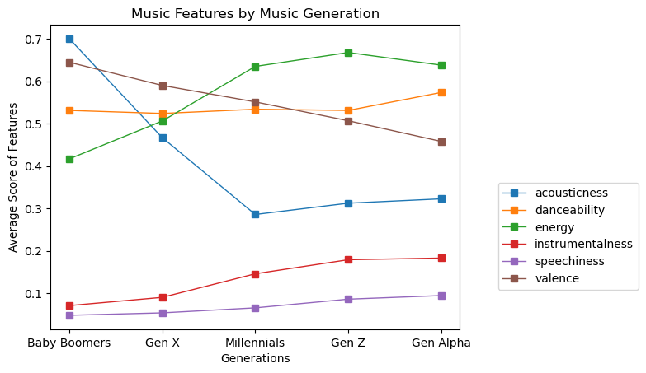
Music Features across Generations
Because we want to understand and potentially predict what music will sound like in the next generation, we look at what types of features of tracks are popular now and in the past.
Notes:
Speaker: Dayna
Music Feature Trends
Features like acoustic ness have declined as we look at the mean of the scores ( 0-1), indicating that songs with music in the background has been more popular as time has gone on.
Features such as instrumentalness and spechiness remain low in score compared to other features but have increased over time, indicating that generations are gradually enjoying more songs that have words ( rap, spoken word, rap features, interludes etc.) and more instruments have increased over time
Top features in the most recent generations (Millennials, Gen Z, Gen Alpha) include energy, danceability, valence (postiveness) align with current consumption of music across social media apps like TikTok ( think viral dances and uses in marketing, advertising etc)
Lastly we see that while valence has a high score, it has decreased across generations, suggesting that the content of music has evolved over time that has more than just positivity, alluding too songs now discuss more serious and emotional topics that before
Rihanna - Umbrella, 2007 top artist of Gen Z generation0

Slide 13
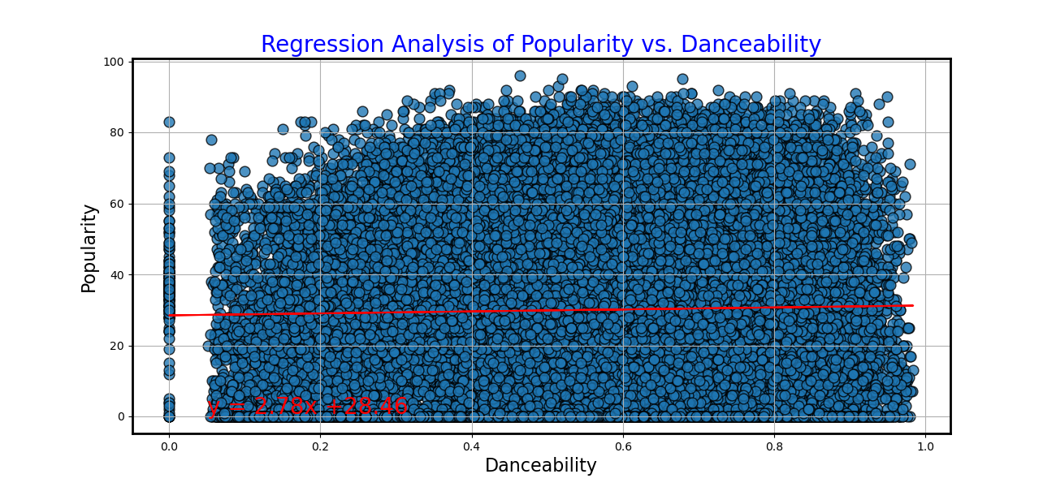
Hypothesis and Testing
The Correlation Coefficient is: 0.02
The r-value is: 0.00051
The p-value is: (3.4233363449656103e-10, 5)
We also look to see how one of the high rated features, danceability, correlates to a track’s popularity. Based on the results of the regression, we see that one feature of a track alone does not necessarily warrant a popular song. Thus thinking that what makes a song popular is a combination of a song’s features, the time in which it was released.
Notes:
Speaker: Dayna
The correlation ‘r’ measures the strength of the linear relationship between two quantitative variables. ‘r’ is always a number between -1 and 1.
r > 0 indicates a positive association.
The r-value here, while positive, is still a low number suggesting that the correlation is weak.
The P-value is the probability that you would have found the current result if the correlation coefficient were in fact zero (null hypothesis). If this probability is lower than the conventional 5% (P<0.05) the correlation coefficient is called statistically significant.
Here, our p-value, while positive, is significantly small indicating that the correlation coefficient is minimally statistically significant.

Slide 14
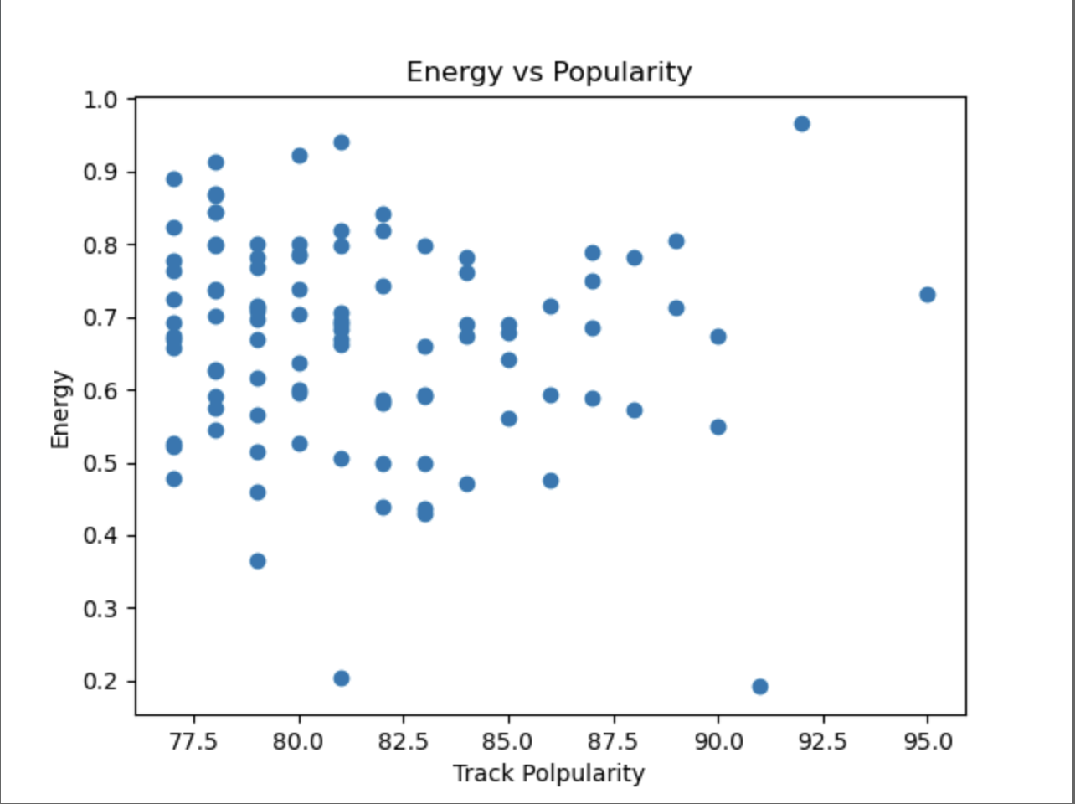
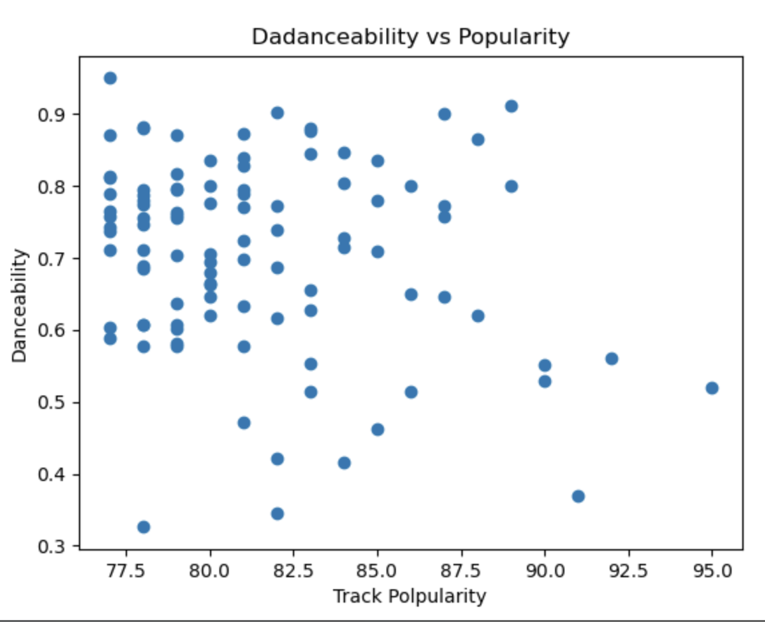
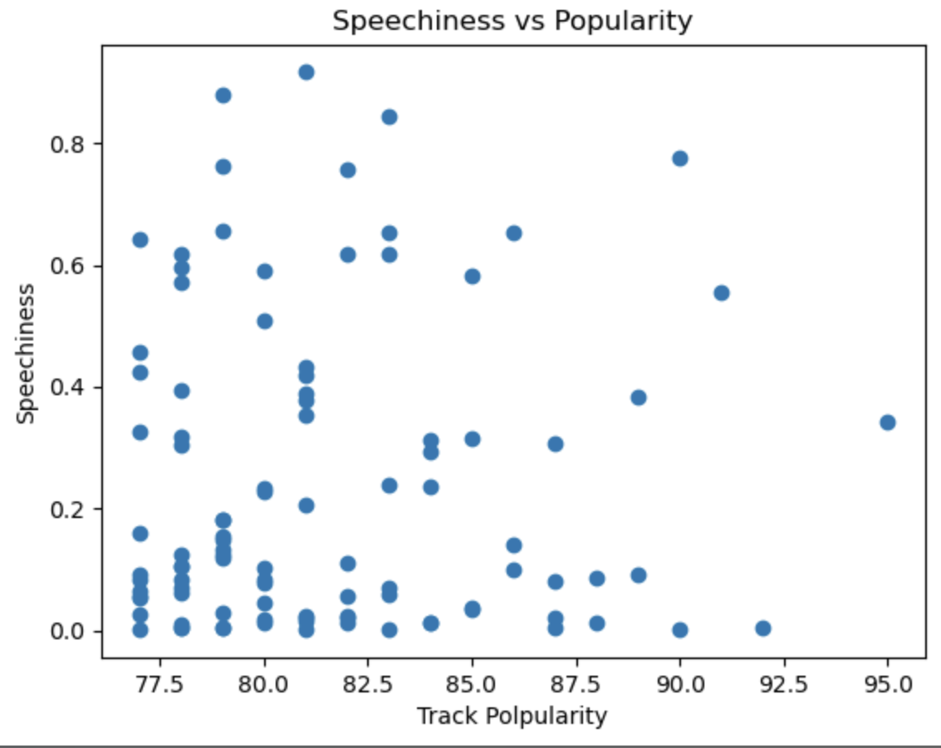
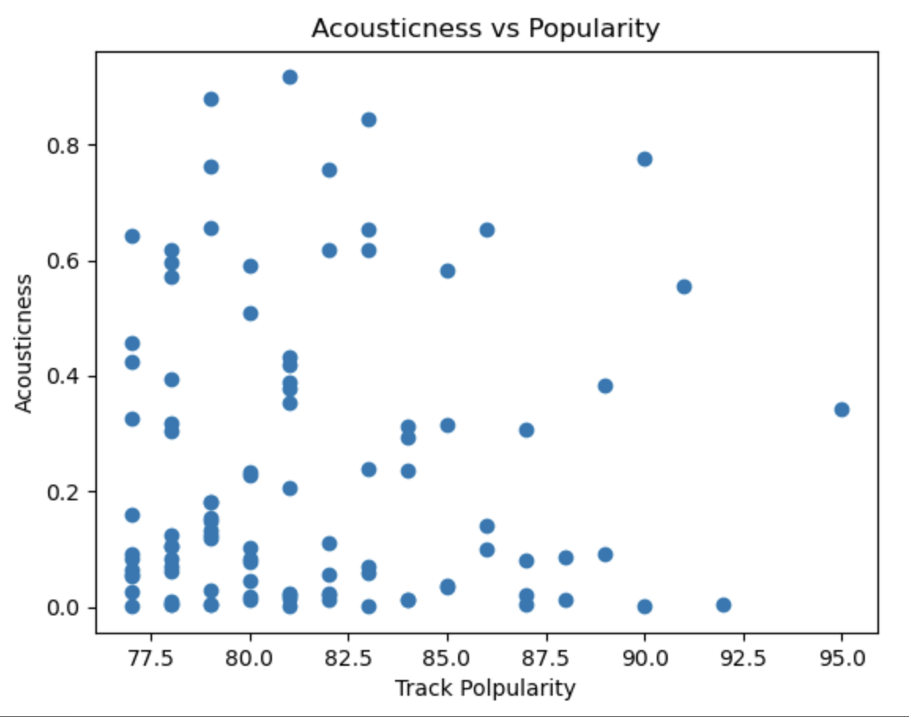
Hypothesis and Testing Cont’d
Danceability vs. Popularity
When we look at the Top 100 songs streamed each year since 2022, we see the top features across generations ( Danceability, Energy, Valence) are clustered similarly with high scores of the features all having similar popularity scores ( between ~77-85). Also aligning with the less favorable features like Speechiness and Acousticness having low scores when attributed to a song with a favorable popularity score.
Notes:
Speaker: Dayna
The correlation ‘r’ measures the strength of the linear relationship between two quantitative variables. ‘r’ is always a number between -1 and 1.
r > 0 indicates a positive association.
The r-value here, while positive, is still a low number suggesting that the correlation is weak.
The P-value is the probability that you would have found the current result if the correlation coefficient were in fact zero (null hypothesis). If this probability is lower than the conventional 5% (P<0.05) the correlation coefficient is called statistically significant.
Here, our p-value, while positive, is significantly small indicating that the correlation coefficient is minimally statistically significant.

Slide 15
Conclusion
Based on the trends of popular genres that transcend generations, as well as the measurement of various track features in each generation we believe we can predict the common trends for the next generation of music listeners
Prediction for Music of Generation Beta
Genre(s) | Common Track features | Variety of Music
Tracks are likely to be genre-bending/ genre agnostic | Positive tracks that are able to be danced to with high energy | High volume of tracks to consume
Notes:
Speaker: Dayna
We see that one feature alone can’t determine the popularity of a single track, but we can infer that if a track has multiple features that popular of the generation in which a track is released, it will likely draw an audience for consumption.
SOngs with these features also do well on TIkTok, Twitch, and are background to viral social media trends

Slide 16
APPENDIX

Slide 17
Audio Features**
key: The key the track is in. Integers map to pitches using standard Pitch Class notation. E.g. 0 = C, 1 = C♯/D♭, 2 = D, and so on. If no key was detected, the value is -1
loudness: The overall loudness of a track in decibels (dB)
mode: Mode indicates the modality (major or minor) of a track, the type of scale from which its melodic content is derived. Major is represented by 1 and minor is 0
speechiness: Speechiness detects the presence of spoken words in a track. The more exclusively speech-like the recording (e.g. talk show, audio book, poetry), the closer to 1.0 the attribute value. Values above 0.66 describe tracks that are probably made entirely of spoken words. Values between 0.33 and 0.66 describe tracks that may contain both music and speech, either in sections or layered, including such cases as rap music. Values below 0.33 most likely represent music and other non-speech-like tracks
acousticness: A confidence measure from 0.0 to 1.0 of whether the track is acoustic. 1.0 represents high confidence the track is acoustic
instrumentalness: Predicts whether a track contains no vocals. "Ooh" and "aah" sounds are treated as instrumental in this context. Rap or spoken word tracks are clearly "vocal". The closer the instrumentalness value is to 1.0, the greater likelihood the track contains no vocal content
liveness: Detects the presence of an audience in the recording. Higher liveness values represent an increased probability that the track was performed live. A value above 0.8 provides strong likelihood that the track is live
valence: A measure from 0.0 to 1.0 describing the musical positiveness conveyed by a track. Tracks with high valence sound more positive (e.g. happy, cheerful, euphoric), while tracks with low valence sound more negative (e.g. sad, depressed, angry)
tempo: The overall estimated tempo of a track in beats per minute (BPM). In musical terminology, tempo is the speed or pace of a given piece and derives directly from the average beat duration
time_signature: An estimated time signature. The time signature (meter) is a notational convention to specify how many beats are in each bar (or measure). The time signature ranges from 3 to 7 indicating time signatures of 3/4, to 7/4.
track_genre: The genre in which the track belongs
Column Description
track_id: The Spotify ID for the track
artists: The artists' names who performed the track. If there is more than one artist, they are separated by a ;
album_name: The album name in which the track appears
track_name: Name of the track
popularity: The popularity of a track is a value between 0 and 100, with 100 being the most popular. The popularity is calculated by algorithm and is based, in the most part, on the total number of plays the track has had and how recent those plays are. Generally speaking, songs that are being played a lot now will have a higher popularity than songs that were played a lot in the past. Duplicate tracks (e.g. the same track from a single and an album) are rated independently. Artist and album popularity is derived mathematically from track popularity.
duration_ms: The track length in milliseconds
explicit: Whether or not the track has explicit lyrics (true = yes it does; false = no it does not OR unknown)
danceability: Danceability describes how suitable a track is for dancing based on a combination of musical elements including tempo, rhythm stability, beat strength, and overall regularity. A value of 0.0 is least danceable and 1.0 is most danceable
energy: Energy is a measure from 0.0 to 1.0 and represents a perceptual measure of intensity and activity. Typically, energetic tracks feel fast, loud, and noisy. For example, death metal has high energy, while a Bach prelude scores low on the scale

